Slide 1
1.4 video

Slide 2
Objective
Show understanding of the characteristics of video streams:
  the frame rate (frames/second)
  interlaced and progressive encoding（逐行和隔行编码）
  video interframe compression algorithms and spatial and temporal redundancy
  multimedia container formats

Slide 3
Video
  The rapid display of a sequence of images.
  Creates an illusion of movement
  Each image is slightly different from the previous one.

Slide 4
Characteristics of video streams
Frame: A frame is one of the many still images which compose (构成) the complete moving picture.
Frame rate—— the number of frames per second
Film often shot at the frame rate of 24 frame/s

Slide 5

Interlaced 隔行扫描 vs progressive 逐行扫描
Interlaced
  Example:
  The first pass displays all the odd numbered lines, from the top left corner to the bottom right corner. The second pass displays the second and all even numbered lines, filling in the gaps in the first scan.

Slide 6
Interlaced 隔行扫描 vs progressive 逐行扫描
Progressive
  Updates all scan lines in each frame in sequence.
  The main advantage with progressive scan is that motion appears smoother and more realistic.

Slide 7
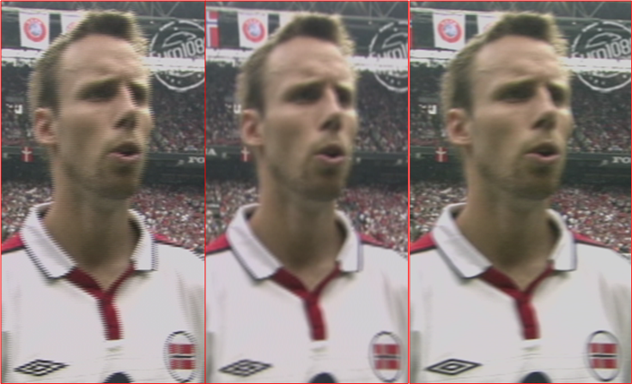
Comparion
Interlaced
Progressive

Slide 8

Comparion
Progressive
Interlaced
Modified Interlaced

Slide 9
Question
Why do we need interlaced scanning?

Slide 10

Video compression method
Spatial redundancy 空间冗余: This is similar to the focus on "redundancy" in bitmap files. Is there a similar sequence of pixels that can be compressed in a single frame?

Slide 11
Video compression method
Temporal redundancy 时间冗余：Is there a series of similar pixels at the same position in consecutive frames? This is related to the movement of objects in the picture. In this case, we don‘t need to repeat them in every frame. A video filled with marathon runners won’t compress like a landscape video.
  在连续帧中的相同位置是否存在一系列相似像素？这与画面中物体的移动情况有关。在这种情况下，我们不需要在每个帧中重复它们。一个充满马拉松运动员的视频不会像风景视频压缩得那么多。

Slide 12
Video compression method
lnterframe coding 帧间编码：lnterframe coding addresses the issue of temporal redundancy. The encoding method is based on the idea of key frames, which store data for all the picture, and intermediar frames which store only the differences from the next intermediar frame or key frame.
  帧间编码解决了时间冗余问题。该编码方法基于关键帧和中间帧的思想，关键帧存储所有图片的数据，中间帧只存储与下一个帧之间的差异。这能产生大量可以被压缩的信息。

Slide 13
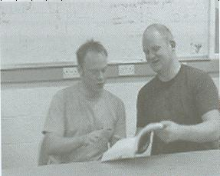
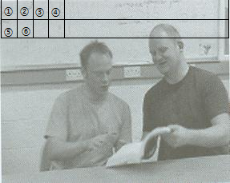
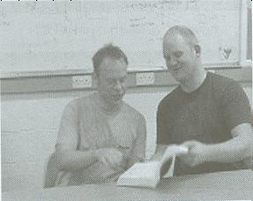
Intraframe compression
帧内压缩
Interframe compression
帧间压缩

Slide 14
Multimedia Container Formats 多媒体封装格式
Multimedia Container Format (MCF) encapsulates （封装） multiple video, audio, and subtitle streams, along with the synchronization information in one file.
The key issue is that there is correct synchronisation between the picture display and the accompanying sound commentary.

Slide 15
Multimedia Container Formats 多媒体封装格式
The most popular multimedia containers are:
  AVI (standard Microsoft Windows container).
  MOV (standard QuickTime container).
  MP4 (standard container for the MPEG-4 multimedia portfolio).
  Matroska (not standard for any codec or system, but it is an open standard. Application: MKV).
  ASF (standard container for Microsoft WMA and WMV).

Slide 16
Streaming media
Streaming media means that a series of media data is sent after segmentation and can be viewed while transmitting. If you do not use this technology, you must download the entire media file before use.
Streaming media storage size is calculated from the streaming bandwidth and length of the media using the following formula (for a single user and file):
  storage size (in megabytes) = length (in seconds) × bit rate (in bit/s) / (8 × 1024 × 1024)
  One hour of video encoded at 300 kbit/s will be:
  (3,600 s × 300,000 bit/s) / (8×1024×1024) requires around 128 MB of storage.

Slide 17
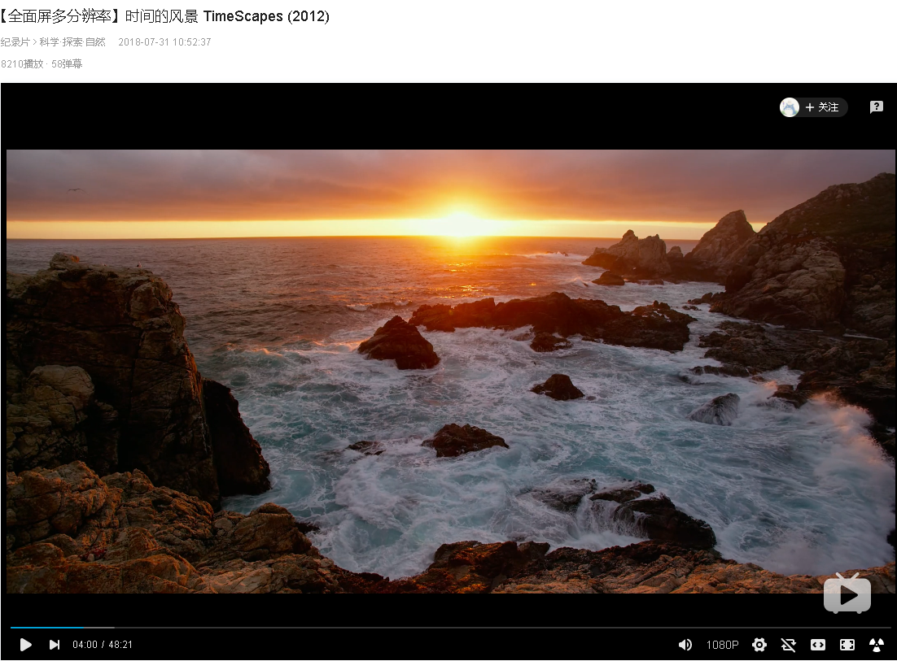
Streaming media

Slide 18
Streaming media
Streaming media means that a series of media data is sent after segmentation and can be viewed while transmitting. If you do not use this technology, you must download the entire media file before use.
Streaming media storage size is calculated from the streaming bandwidth and length of the media using the following formula (for a single user and file):
  storage size (in megabytes) = length (in seconds) × bit rate (in bit/s) / (8 × 1024 × 1024)
  One hour of video encoded at 300 kbit/s will be:
  (3,600 s × 300,000 bit/s) / (8×1024×1024) requires around 128 MB of storage.

